Slide 1
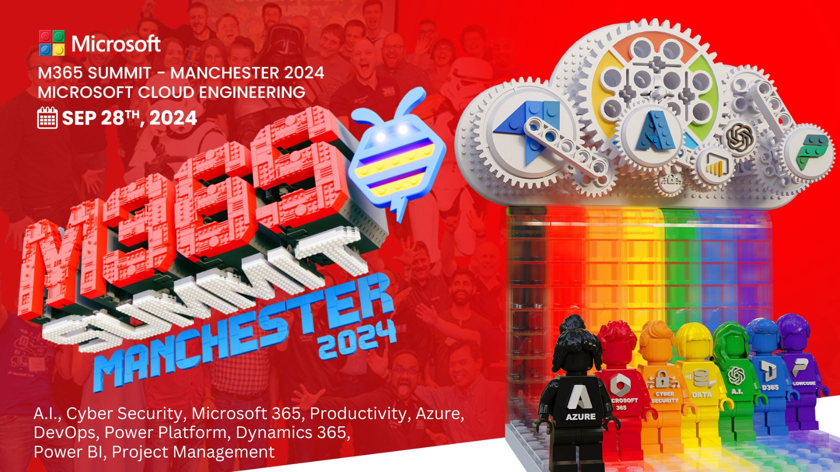

Slide 2
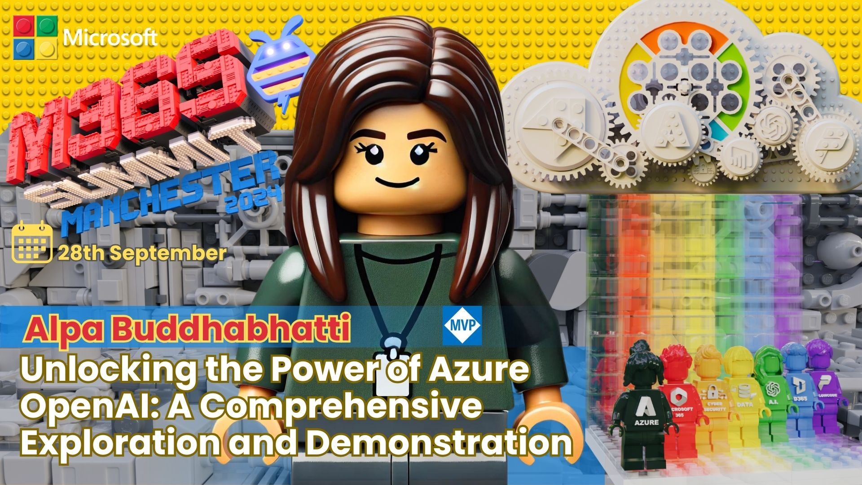

Slide 3


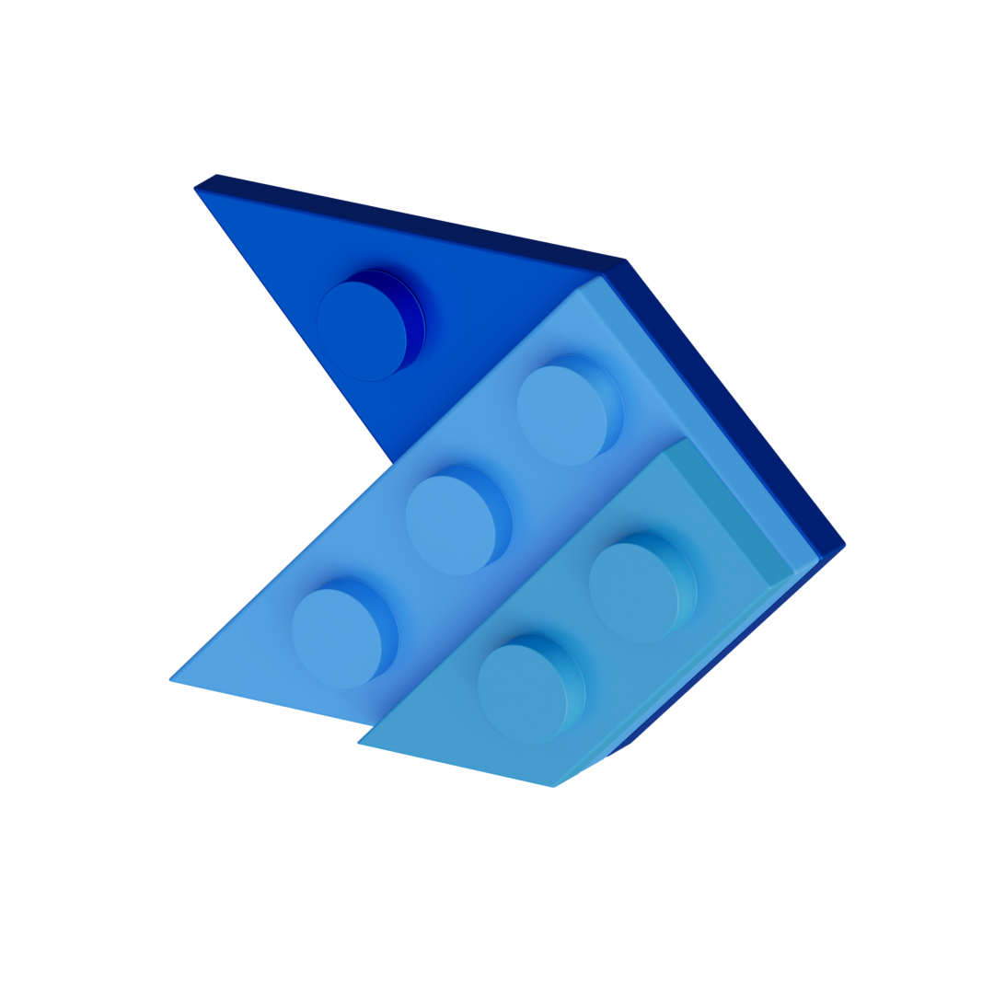






Alpa Buddhabhatti
She/Her
Azure Data Engineer/Trainer
alpabuddhabhatti
@AlpaB7
Microsoft MVP
Microsoft Certified Trainer(MCT)
Azure Developer(AZ-204)
Azure Data Engineer(DP-203)
Azure Data Scientist(DP-100)
Azure Administrator(AZ-104)
alpaBuddhabhatti/AzureOpenAI
@meetalpa
@alpabuddhabhatti

Slide 4


Abstract
During this concise yet comprehensive session, we’ll immerse ourselves in the realm of Azure OpenAI. We will delve into the fundamental principles, capabilities, and practical use cases of this cutting-edge AI technology. Whether you’re new to Azure OpenAI or seeking a quick refresher, this session will serve as your gateway to unlock its full potential.
In this demonstration, we will focus on the following technologies:
1. Azure OpenAI
2. Azure Data Factory
3. Microsoft Fabric
4. Azure SQL/ LakeHouse
5. Visual studio Code
You’ll gain valuable insights to effectively grasp and employ Azure OpenAI, paving the way for further exploration and integration into your projects.

Slide 5
Agenda
Quick Overview of Azure OpenAI
What it is, Why it's important, and How it works
Demos
Consuming Azure OpenAI in various ways
Knowledgebase Q&A (Blog URL as Knowledge data source)
Orchestrating Azure OpenAI with Azure Data Factory (ADF) for order delay notifications
Natural Language Queries for Structured Databases
Conclusion
Key takeaways and next steps
Q&A
Open floor for questions and answers

Slide 6

1 Azure OpenAI

Slide 7
What is Azure OpenAI
Azure OpenAI is a Platform-as-a-Service (PaaS) that allows you to leverage advanced Large Language Models (LLMs) like GPT or Codex on your own data(whether it is stored within Azure, on-premises, or in other cloud environments or over internet)
Microsoft +OpenAI
Enterprise level security (Azure Private Link, Azure Active Directory, and Azure Role-Based Access Control to help you secure your network, identity, and access)
Enhance Applications
Save time and enhance productivity

Slide 8
Where to use Azure OpenAI
Chatbot Applications
Data Summarization
Q&A Applications
Code Generation
Media Analysis

Slide 9
How to use Azure OpenAI
REST API (Endpoint , Key, etc)
Example:
curl $AZURE_OPENAI_ENDPOINT/openai/deployments/gpt-35-turbo-instruct/completions?api-version=2023-05-15 \
-H "Content-Type: application/json" \
-H "api-key: $AZURE_OPENAI_KEY" \
-d "{\"prompt\": \"Once upon a time\"}"

Slide 10
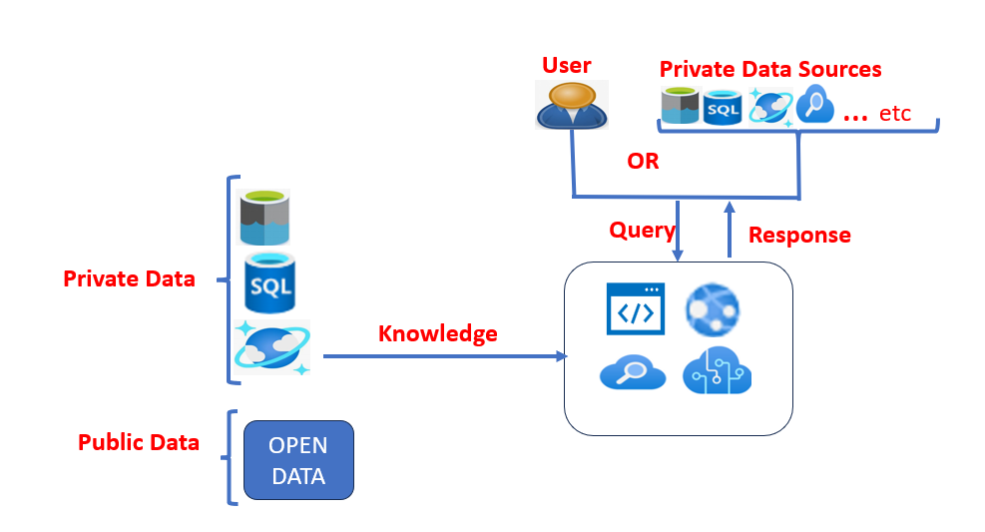
High level design

Slide 11





2
DEMO
py

Slide 12
DEMO 1
Consuming Azure OpenAI Various way
Azure AI studio
Postman
Microsoft Fabric
VS Code
Azure OpenAI Rest URL
API Version
Model name
Method
Header (Content-Type +Key )
Message(Prompt )

Slide 13



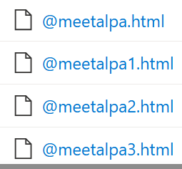
DEMO 2
Knowledgebase Q&A (Blog URL as Knowledge data source)
End-user as Paul
Azure OpenAI
Azure AI search
Azure WebApp
Azure Data Lake Gen2
User Query:
“What is ADF?
Response
“ADF is ….”
Azure AI Search
Index
Search
Medium Blogs as data
Web App
(Chat BOT)
Azure OpenAI
Internal Knowledge
based Data
Developer as Alpa

Slide 14
DEMO 3
Orchestrating Azure OpenAI with Azure Data Factory (ADF) for order delay notifications
Azure OpenAI
Azure Data Factory (Microsoft Fabric)
Azure SQL Database
Send Order Delay Notification
Internal Knowledge
based Data
Azure OpenAI

Slide 15

DEMO 3
Orchestrating Azure OpenAI with Azure Data Factory (ADF) for order delay notifications
Azure OpenAI
Azure SQL Database
Streamlit
VS code
Python
User Query : Show me Orders
Streamlit
Azure OpenAI
Select * from abo.Orders
Python
Database

Slide 16
3
Conclusion

Slide 17
Conclusion
Key takeaways and next steps
Azure OpenAI: Azure AI services enable you to apply natural language processing (NLP) to your own data or public data quickly and easily, making your applications smarter. It works with all kinds of data, including text, images, audio, and video.
Demo 1 – Shows how to integrate Azure OpenAI in various ways.
Demo 2 – Bring Your Own Data (BYOD) using Medium Blog source data
Demo 3 – Automates order delay notifications
Demo 4 – Natural language queries on structured databases.
You can use these ideas with your own data to build knowledge-based chat apps, generate documents like High-Level Designs (HLD), Requests for Proposals (RFP), and generate video, audio, and images, among other possibilities.

Slide 18
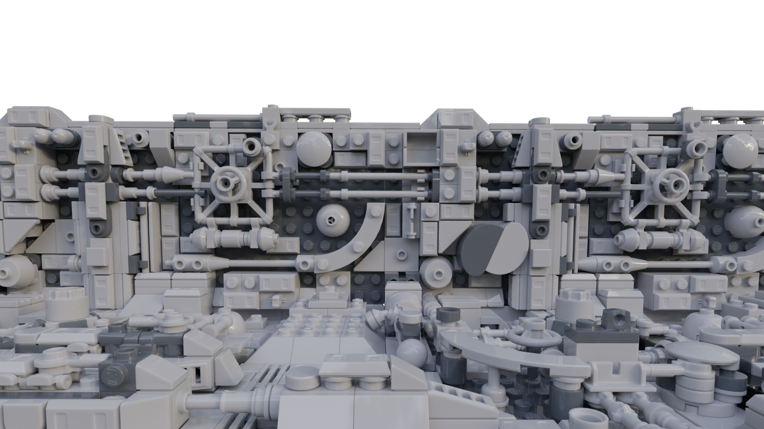
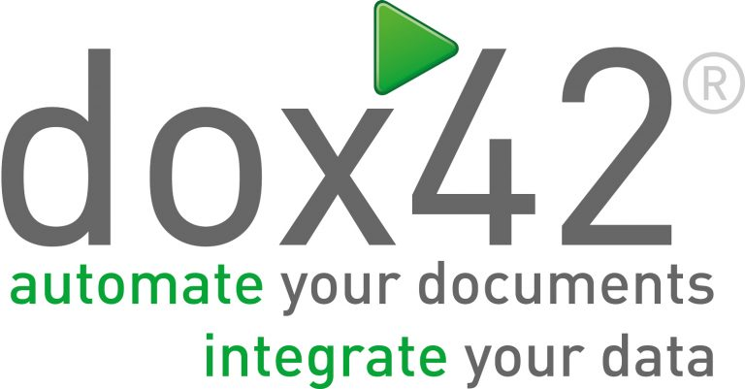
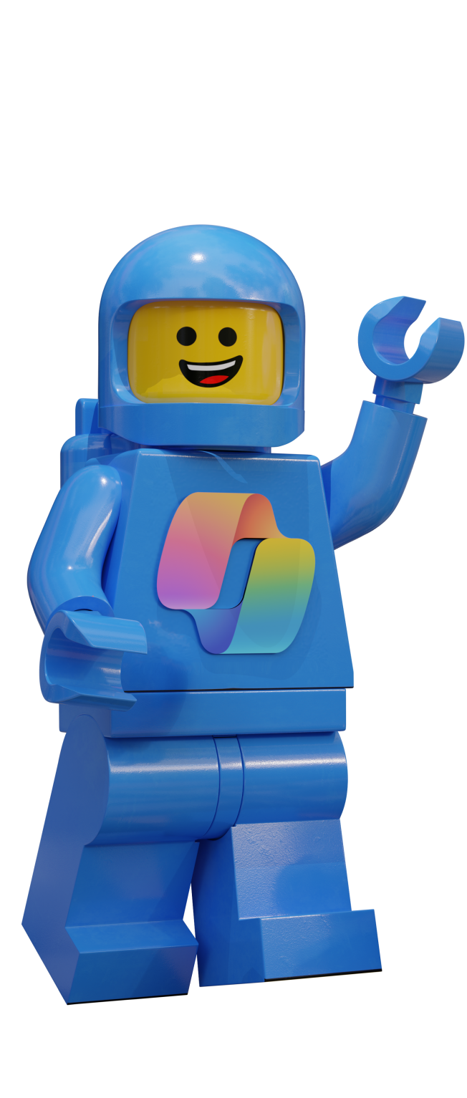
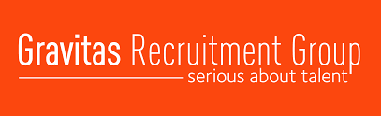



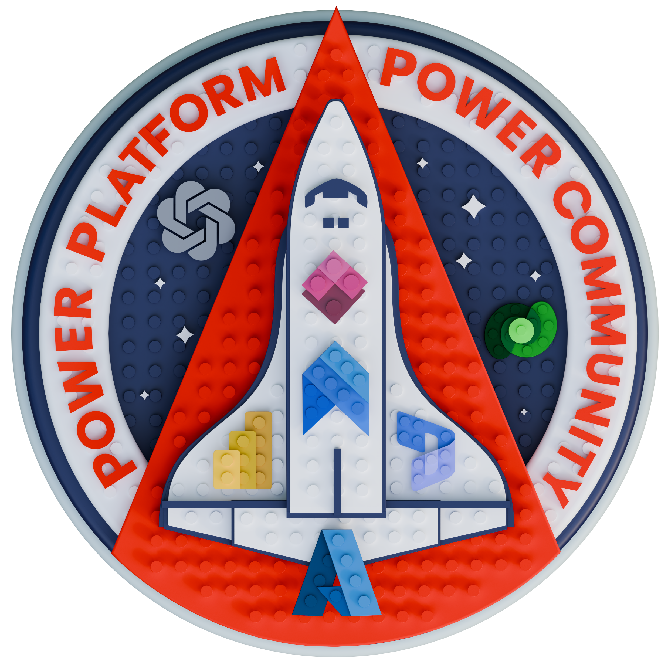
Sponsors
THANK
YOU!

Slide 19
4
Thank you!
Q&A

Slide 20
Alpa Buddhabhatti
She/Her
Azure Data Engineer/Trainer
alpabuddhabhatti
@AlpaB7
Microsoft MVP
Microsoft Certified Trainer(MCT)
Azure Developer(AZ-204)
Azure Data Engineer(DP-203)
Azure Data Scientist(DP-100)
Azure Administrator(AZ-104)
alpaBuddhabhatti/AzureOpenAI
@meetalpa
@alpabuddhabhatti

